Slide 1
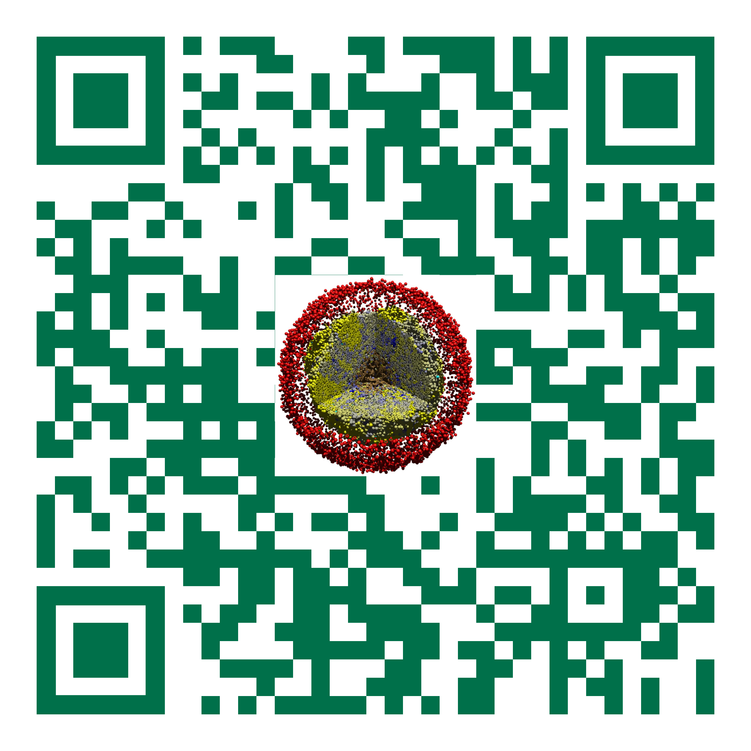
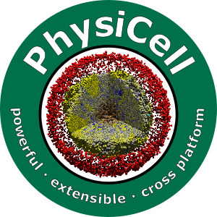

Session 1: Working with PhysiCell Projects
Slides, videos, links and more:
https://github.com/physicell-training/ws2021
Paul Macklin, Ph.D.
@MathCancer
July 15, 2021

Slide 2
Goals
Get a first look at a typical project structure
Learn how to work with sample projects
Get a list of sample projects
Populate a project
Modify settings
Compile and run a populated project
See typical model outputs
Clear out data and reset

Slide 3
Sample projects
It's inefficient (and a little insane) to code new projects entirely from scratch.
So, we provide sample projects:
2D/3D template project
Cancer models
Synthetic multicellular systems
Viral dynamics in tissue
and more …
make [project-name]: populate a sample project (puts all the source files where they belong)
Then use make to compile it
make data-cleanup: clean up the output data
make reset: return to a "clean slate" (depopulate the project)
make list-projects: display all available sample projects
Documentation: User Guide Sections 6, 7.

Slide 4
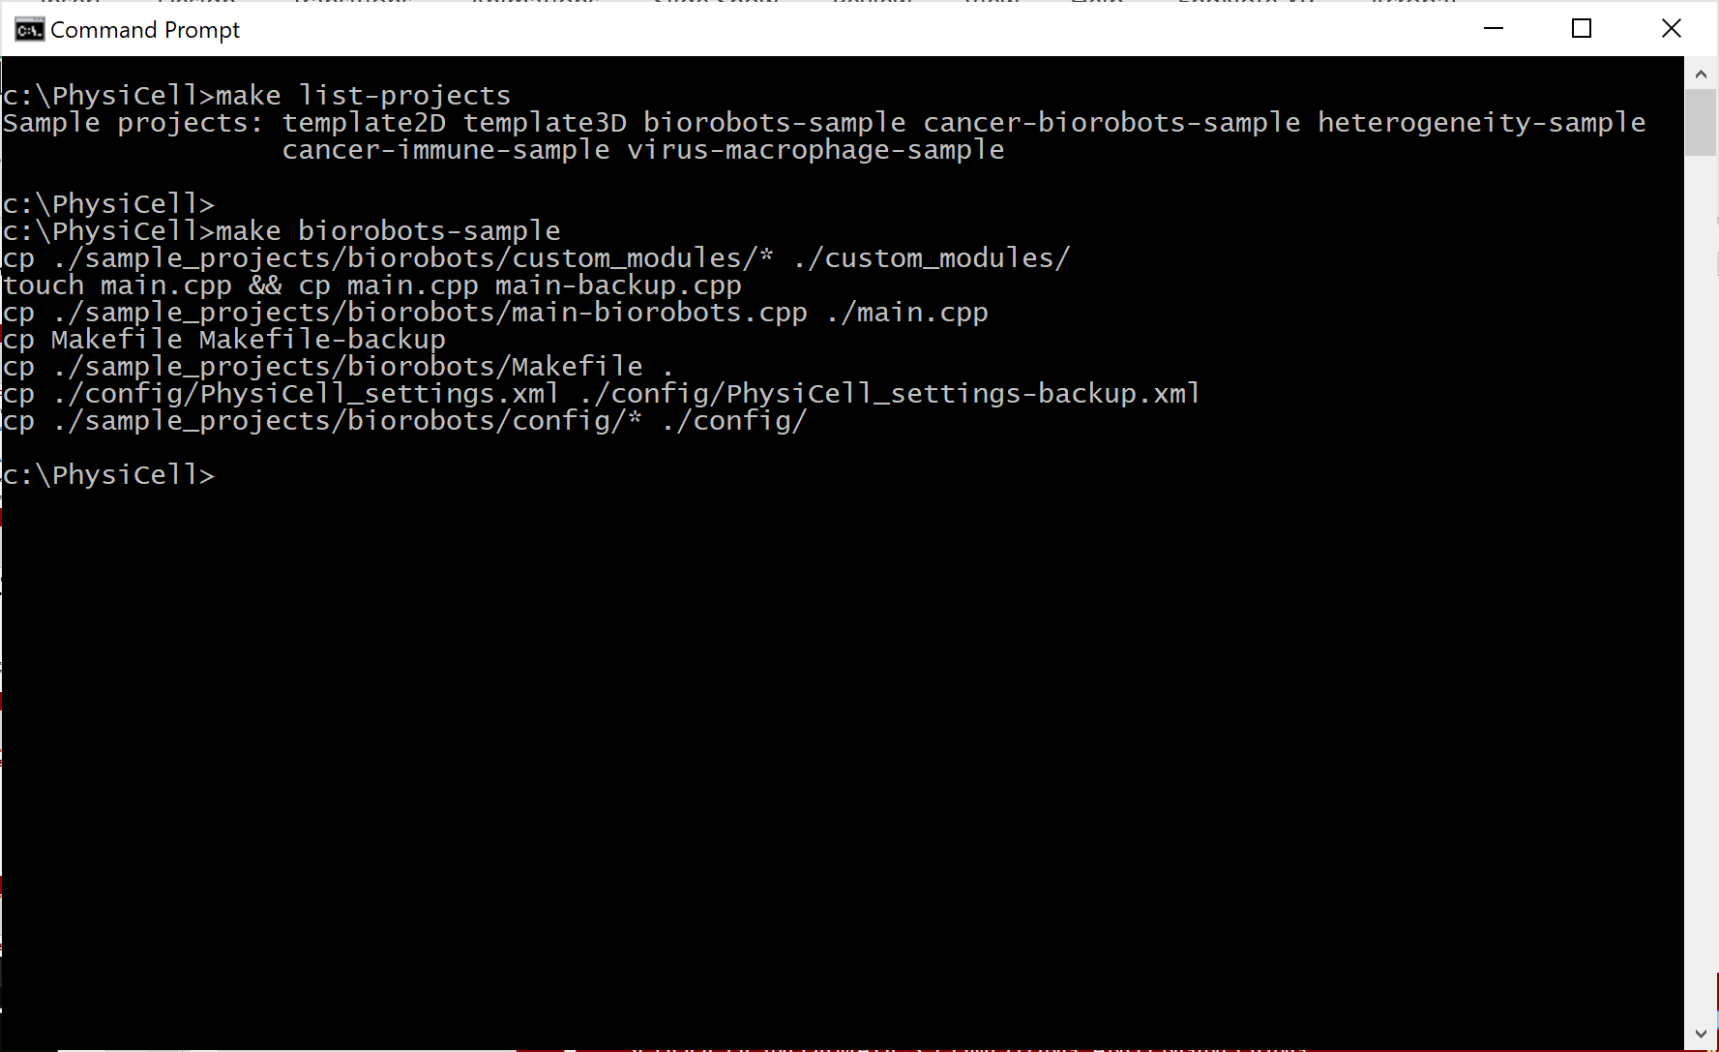
PhysiCell Project Essentials (1)
Each PhysiCell release includes sample projects. To list them:
make list-projects
Your first step is to populate a project.
make <project_name>
Let's use biorobots-sample:
make biorobots-sample
This copies source code, a tailored make file, and configuration files

Slide 5
Let's look at the project structure …

Slide 6
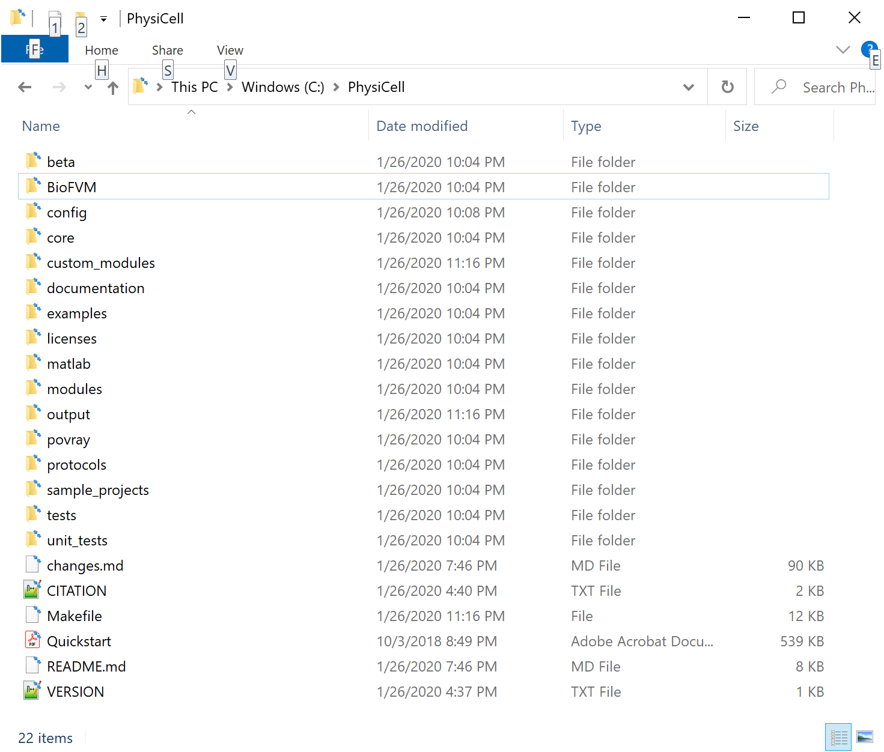
Project directory structure
(key) directories:
./ (root): main source, Makefile, and executable go here
./beta: for beta-testing (don’t use)
./BioFVM: diffusion solver
./config: configuration files
./core: PhysiCell core functions
./custom_modules: put custom code for your project here.
./documentation: user guide, etc.
./examples: deprecated
./licenses: yep
./matlab: scripts and functions to load data in matlab
./modules: standard add-ons for PhysiCell
./output: where data are stored (by default, but can be changed)
./povray: deprecated
./protocols: instructions mostly for maintainers (e.g., release protocols)
./sample_projects: where we add sample projects
./tests: for automated testing (WIP)
./unit_tests: for automated testing (WIP)
Most of your work will be in the red directories

Slide 7
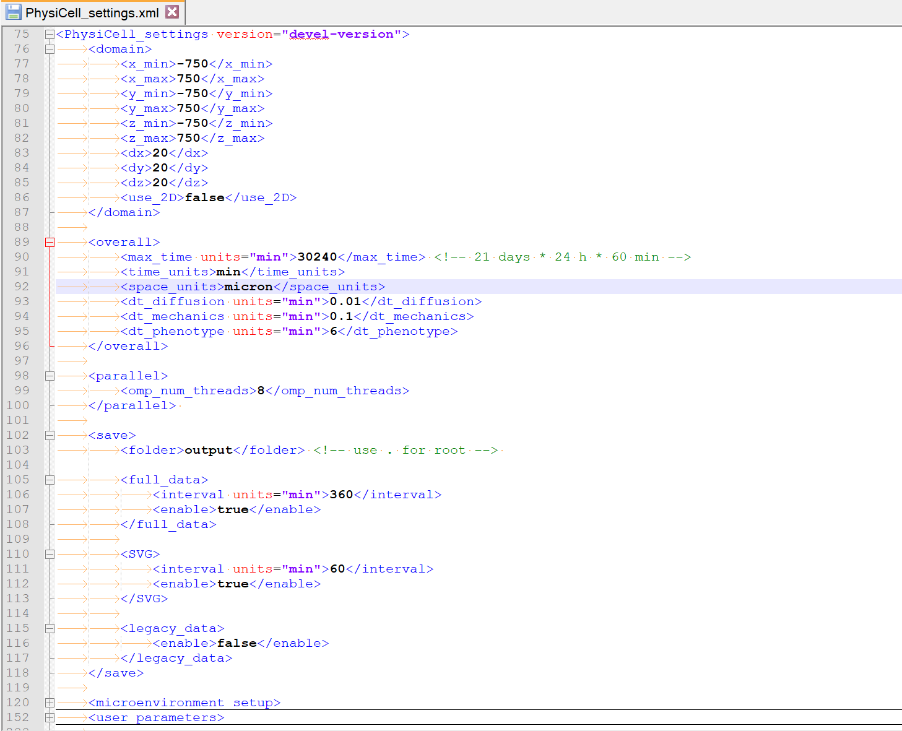
Project structure: config files
Configuration files (XML)
domain: domain size and resolution
overall: general options
Final simulation time
Time step sizes
parallel: parallelization options
Number of threads
save: save options
Save where?
Save SVGs? (how often?)
Save full data? (how often?)
Save legacy data (don't)
microenvironment_setup: diffusion settings
more later
cell_definitions: define different cell types and starting parameters
more later
user_parameters: simulation-specific settings
more later

Slide 8
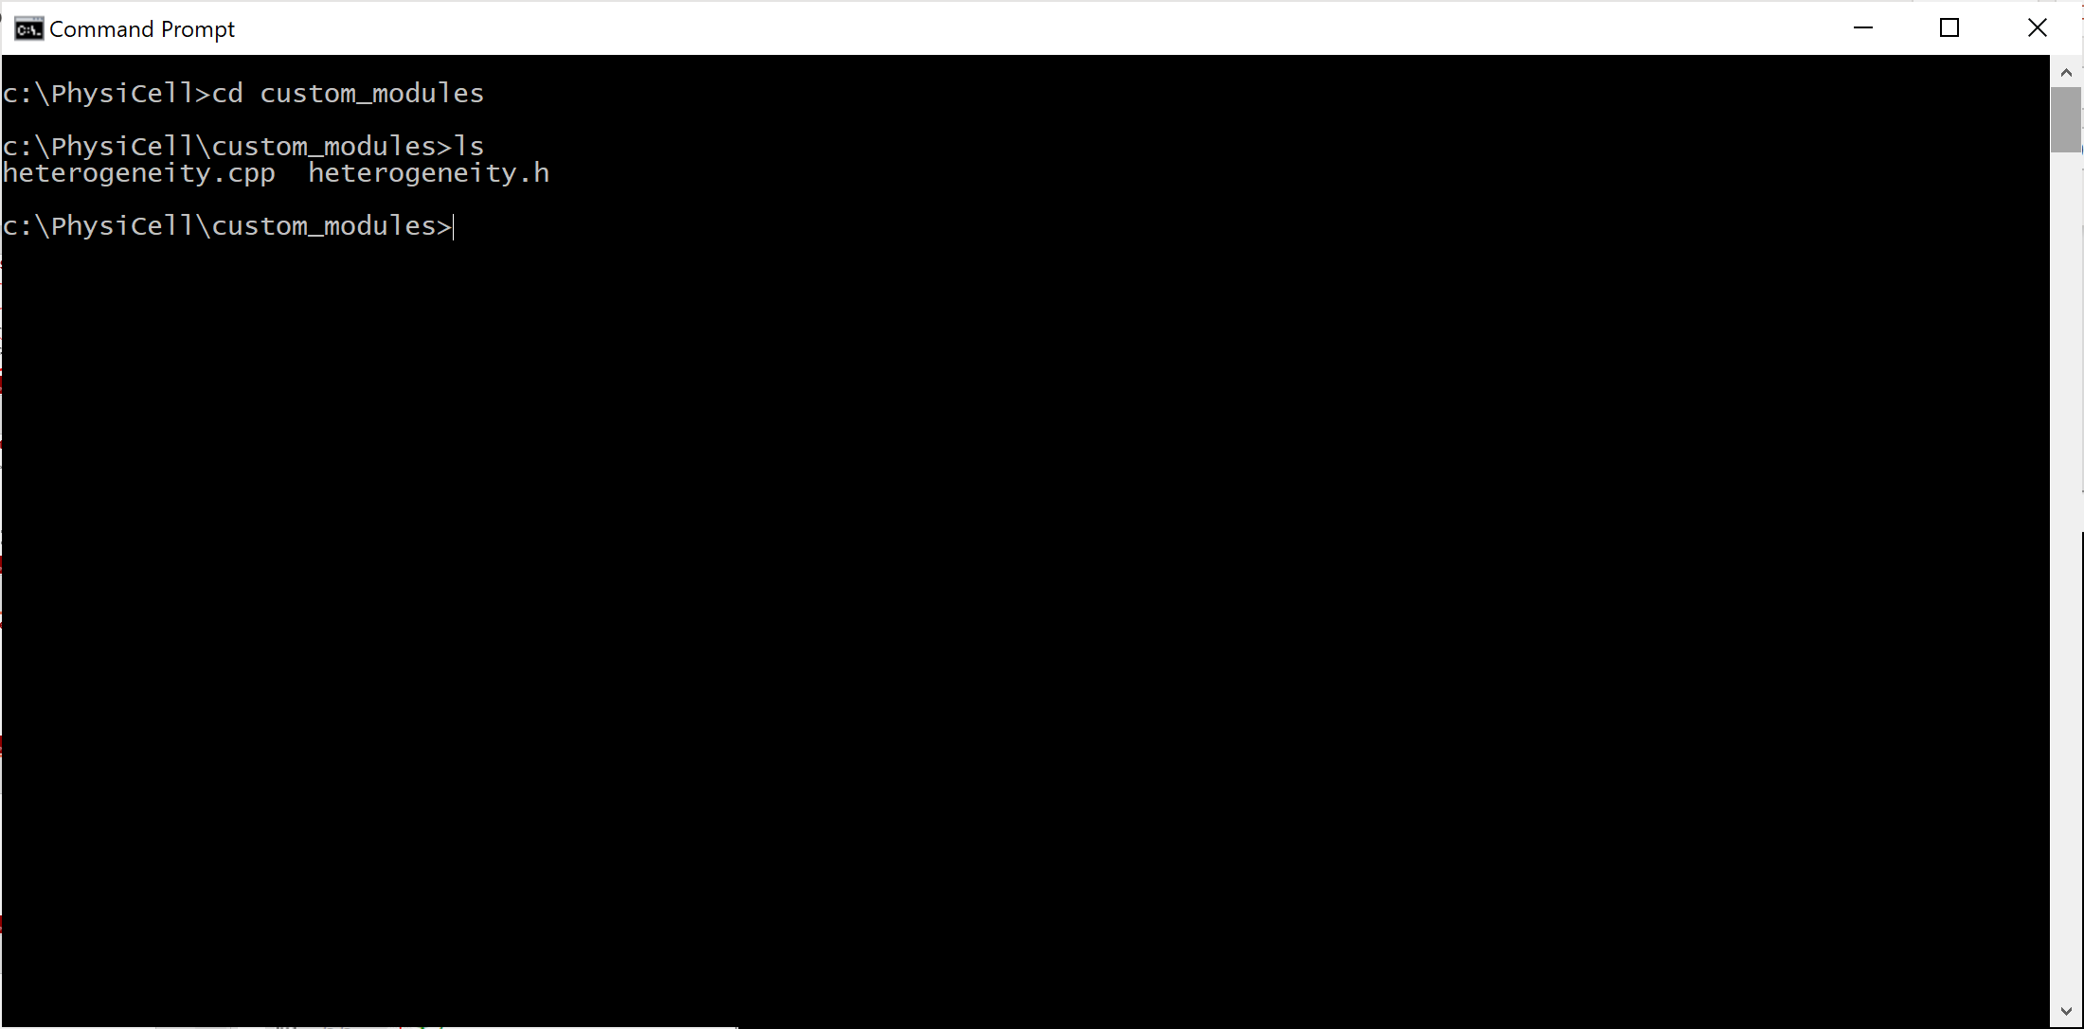
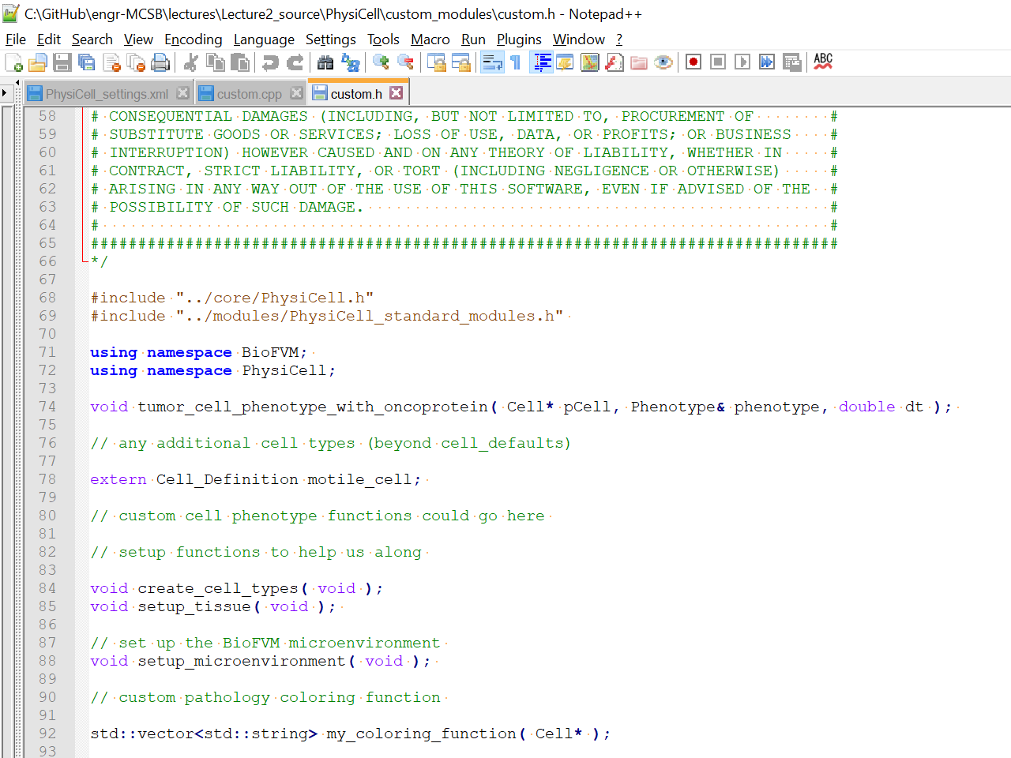
Project structure: custom modules
Custom Modules
Setup functions
Cell definitions
Custom functions
any other modeling
Custom coloring functions

Slide 9
Project structure: custom modules
Custom Modules
Any user-defined globals (at top)
Declared cell types
Setup functions
create_cell_types()
Do all setup on all cell types
Adjust phenotype
Add / adjust custom data
Set functions
setup_tissue()
Place initial cells in microenvironment
Modify each cell as needed
Custom functions
any other modeling
Custom coloring functions

Slide 10
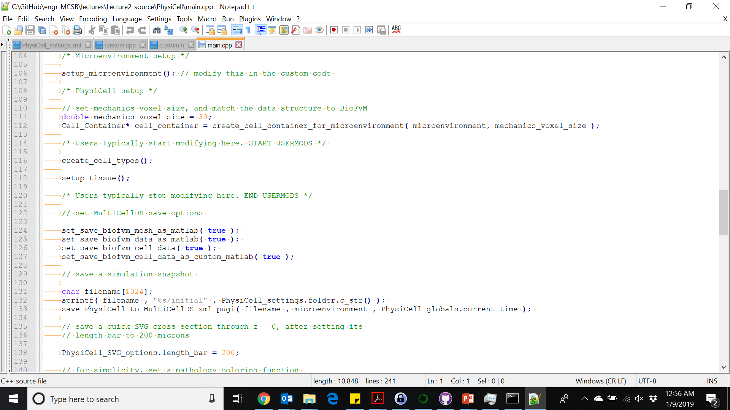
Project structure: main.cpp
main.cpp
(in the root directory)
calls the setup functions

Slide 11
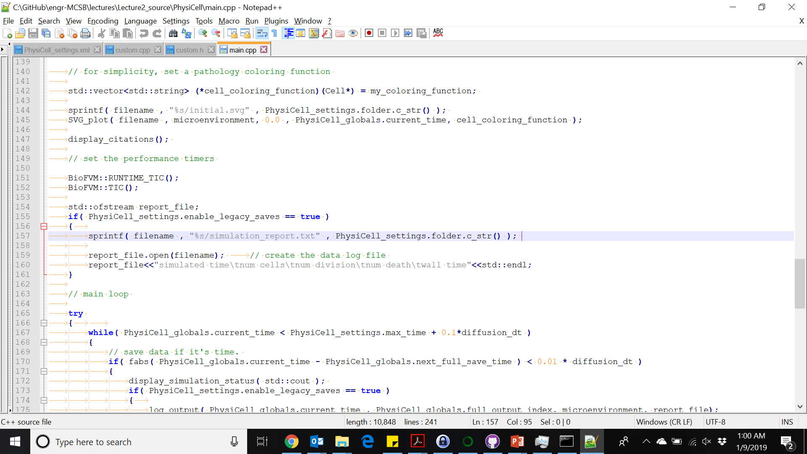
Project structure: main.cpp (continued)
main.cpp
set coloring function

Slide 12
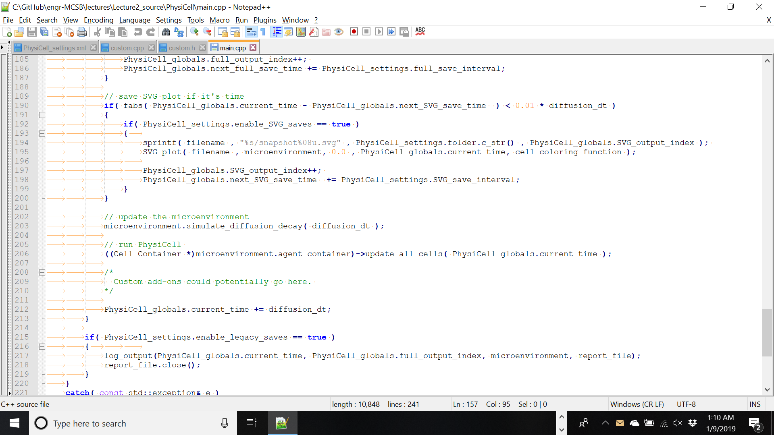
Project structure: main.cpp (continued)
main.cpp
insert custom routines
This would be a good place to put extensions.

Slide 13
Now, let's get back to working with sample projects.

Slide 14
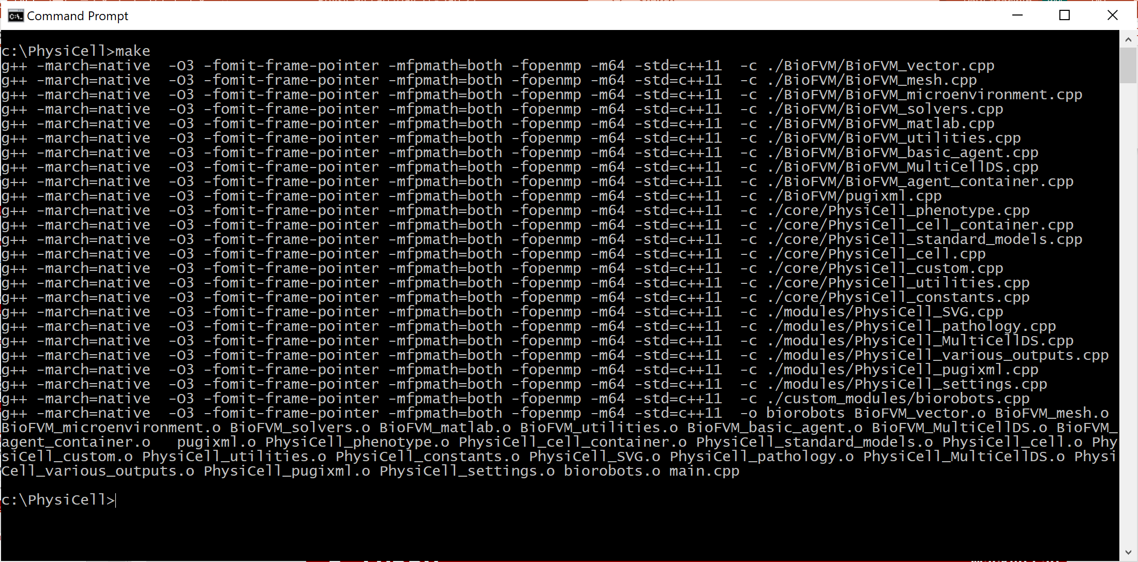
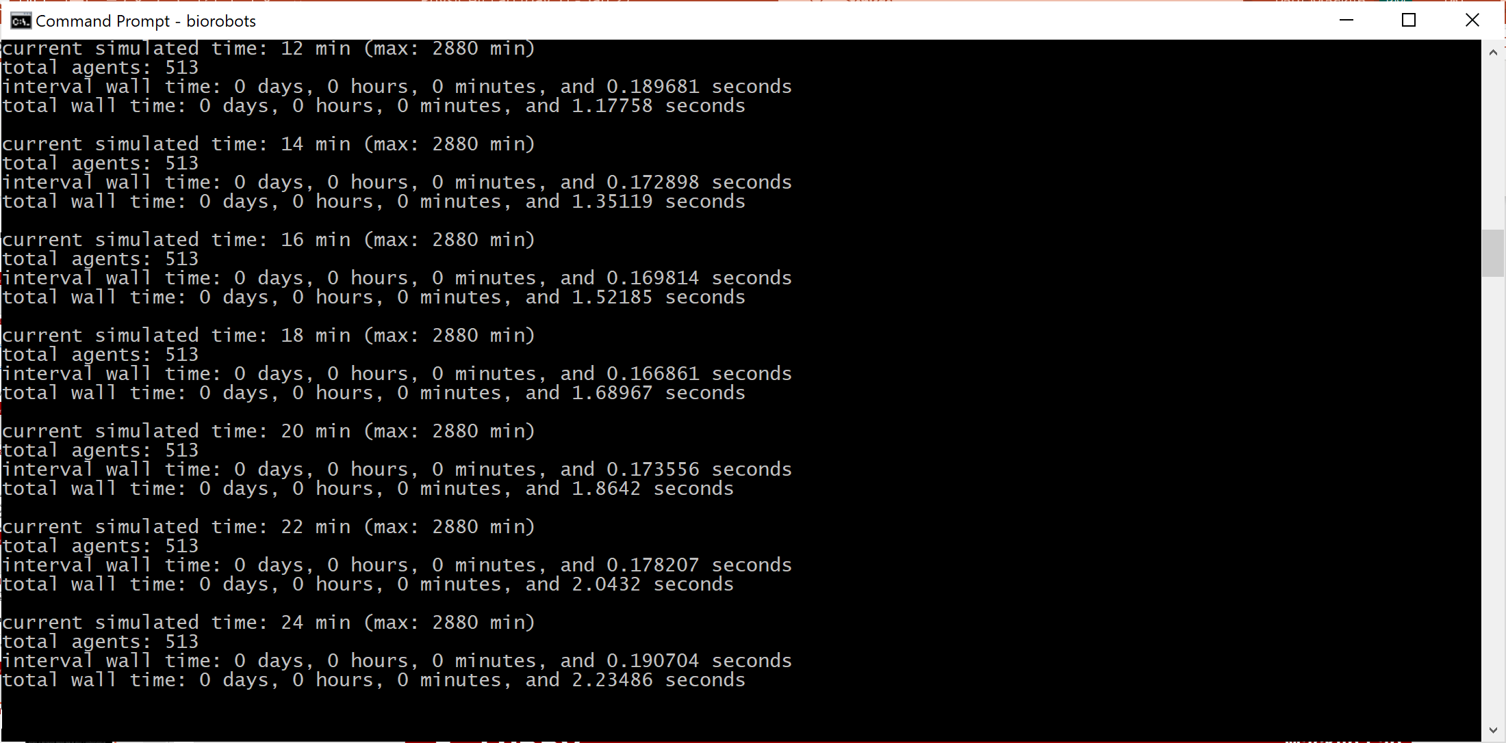
PhysiCell Project Essentials (2)
Now, compile the project
make
Then, run the project
./biorobots (Linux, MacOS)
biorobots.exe (Windows)
This should take about 5 minutes

Slide 15
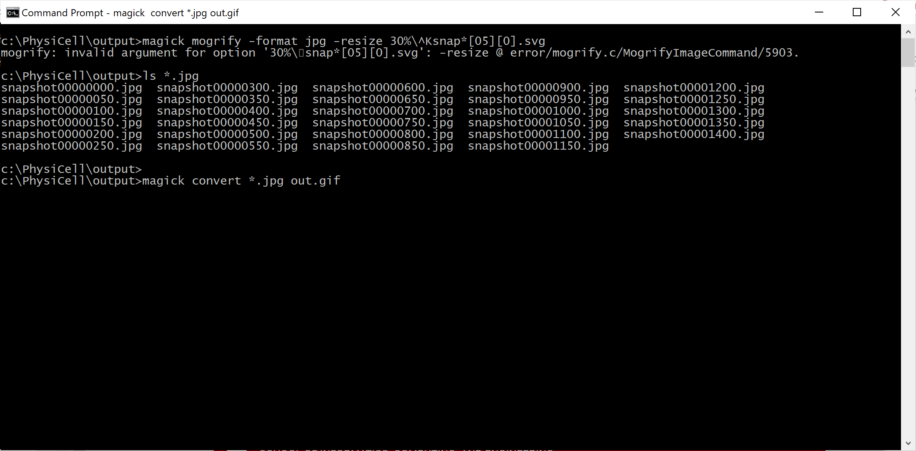
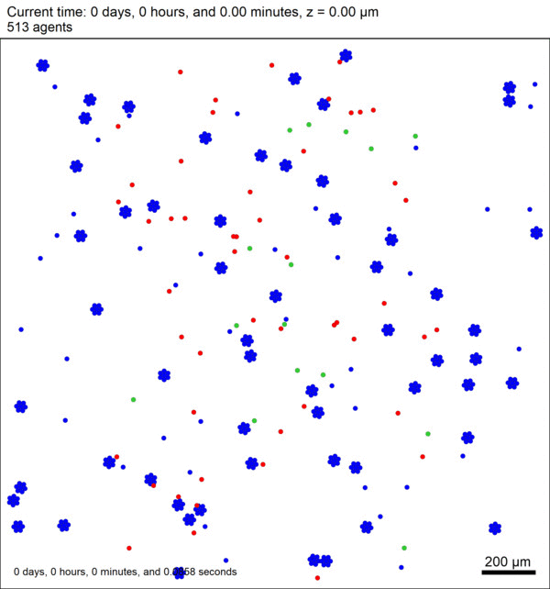
PhysiCell Project Essentials (3)
Look at saved data
Most projects save data to ./output
XML files give metadata, mesh, and substrate info
MAT file save (compressed) substrate and cell data
SVG files are visual quick snapshots
More on loading XML / MAT files in Python later
Let's convert SVG to rescaled JPEG
magick mogrify -format jpg -resize 30% snap*.svg
Convert snapshot00000000.svg, snapshot00000001.svg, ...
magick mogrify -format jpg -resize 30% snap*[05][0].svg
Convert snapshot00000000.svg, snapshot00000050.svg, ...
Now, let's create an animated GIF
magick convert *.jpg out.gif

Slide 16
Working with the images
To convert all the SVG files to PNG format
magick mogrify -format png snap*.svg
To convert every SVG file ending in 0 or 5 to JPG format
magick mogrify -format jpg snap*[05].svg
To convert the JPG files to an animated GIF
magick convert *.jpg out.gif
To create an mp4 movie:
ffmpeg -r 24 -f image2 -i snapshot%08d.jpg -vcodec libx264 -pix_fmt yuv420p -strict -2 -tune animation -crf 15 -acodec aac out.mp4
Handy tricks!
Use make jpeg to create a full set of JPGs
Use make movie easily create the mp4.

Slide 17
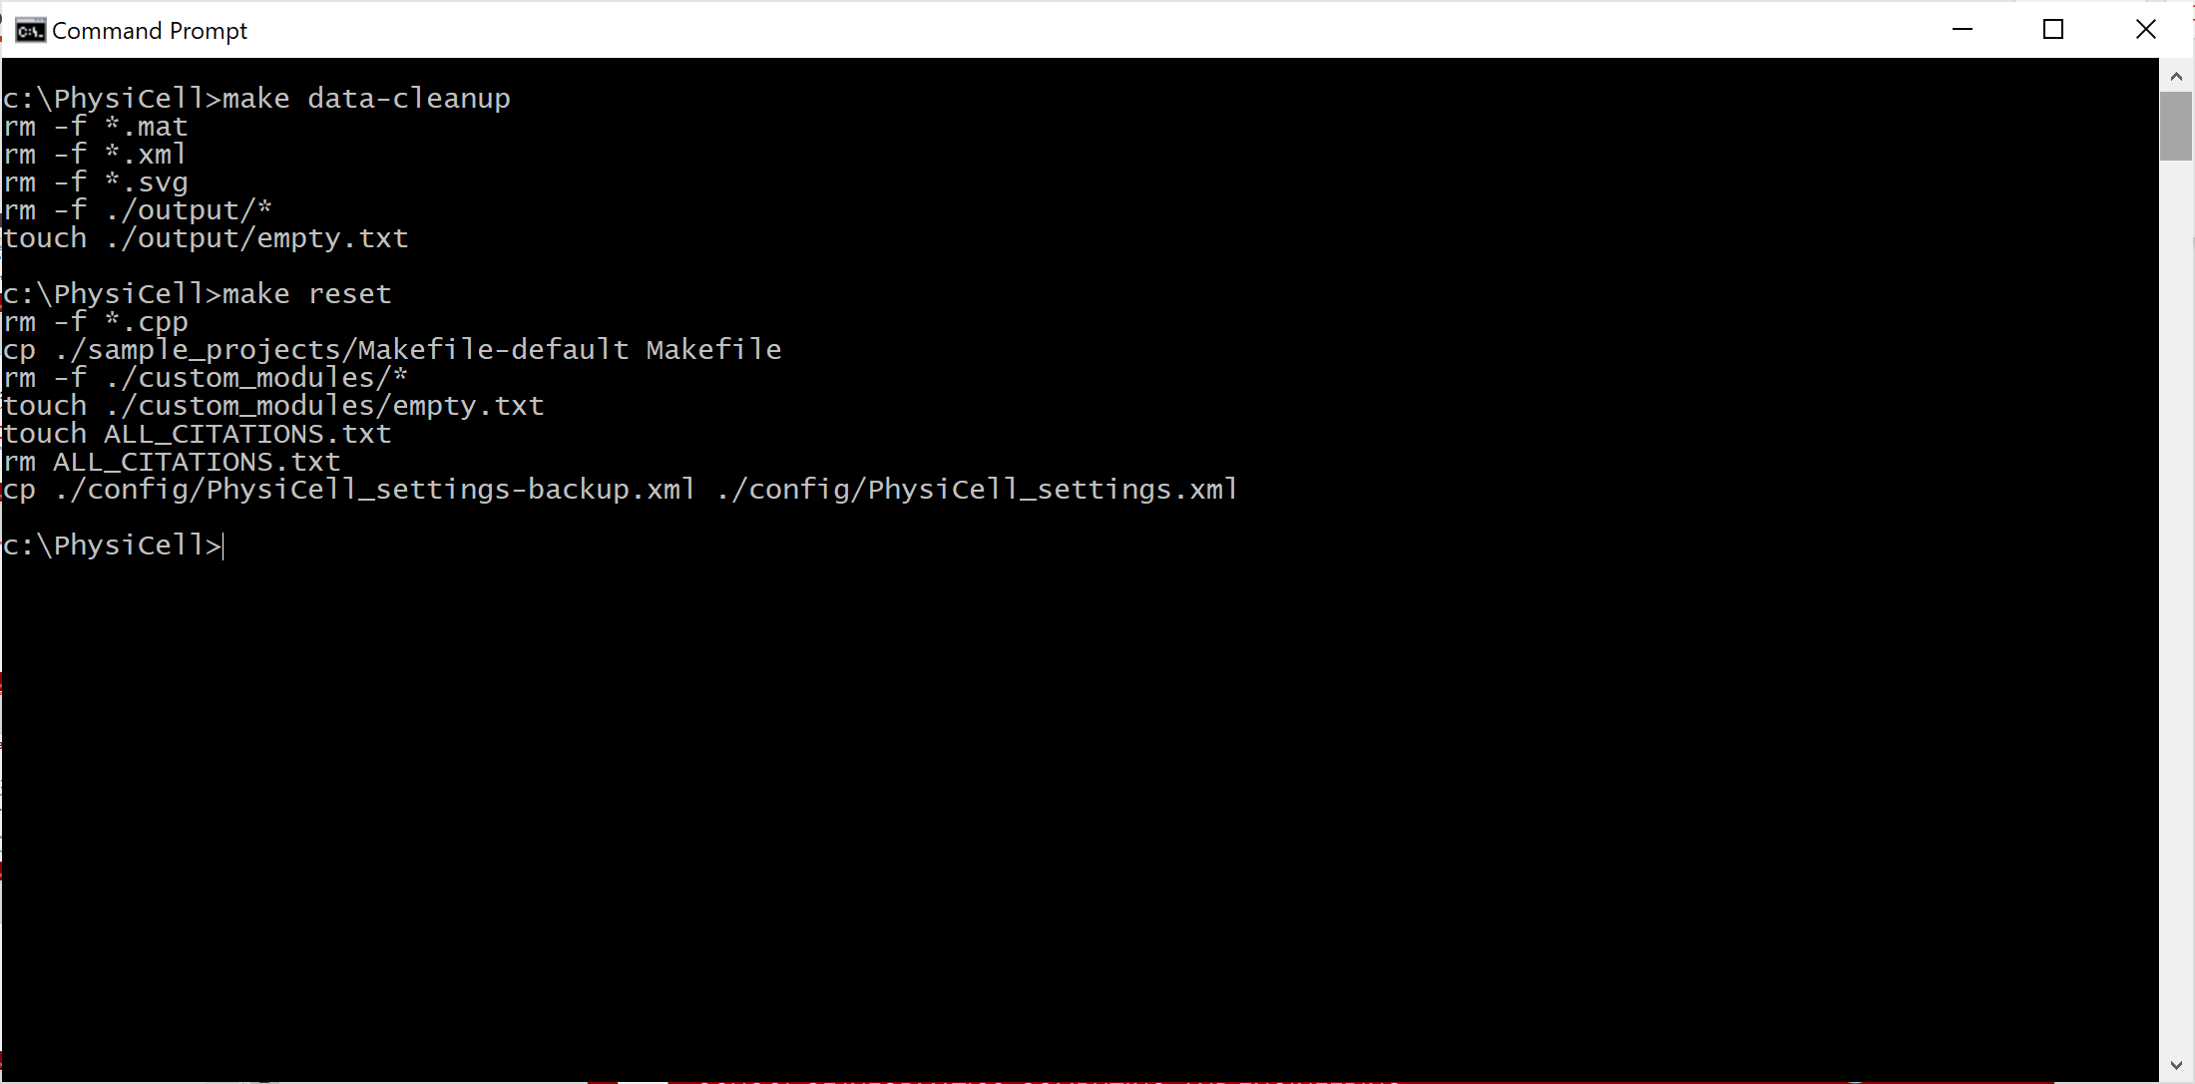
PhysiCell Project Essentials (4)
Data cleanup
Clean up data to get ready
for another run
make data-cleanup
Reset to a clean slate
De-populate the project
Get ready for another project
make reset

Slide 18
Changing settings in a project

Slide 19
XML Refresher (1)
XML stands for eXtensible Markup Language
(Think of it as a generalization of HTML.)
Information in XML are stored in elements. Key elements are:
element name in a start tag
attributes and values
element value
If an element has a value, it must have a matching end tag:
<element_name attribute="attribute value">value</element_name>
If an element has attributes but no value, you can use a more compact form:
<element_name attribute1="attribute 1 value" attribute2="attribute 2 value" />
element
start tag
element value
end tag
element name
attribute name and value

Slide 20
XML Refresher (2)
Just like HTML, XML can have sub-elements:
<element_name attribute1="attribute 1 value" attribute2="attribute 2 value">
<subelement_name attribute="attribute value">subvalue1</subelement_name >
<subelement_name attribute="attribute value">subvalue2</subelement_name >
</element_name >
By convention:
the name of the element is a parameter name
the element's value is the parameter value
attributes are used to store metadata or other clarifications (e.g., units)
<diffusion_coefficient units="micron/min^2">1000</diffusion_coefficient>

Slide 21
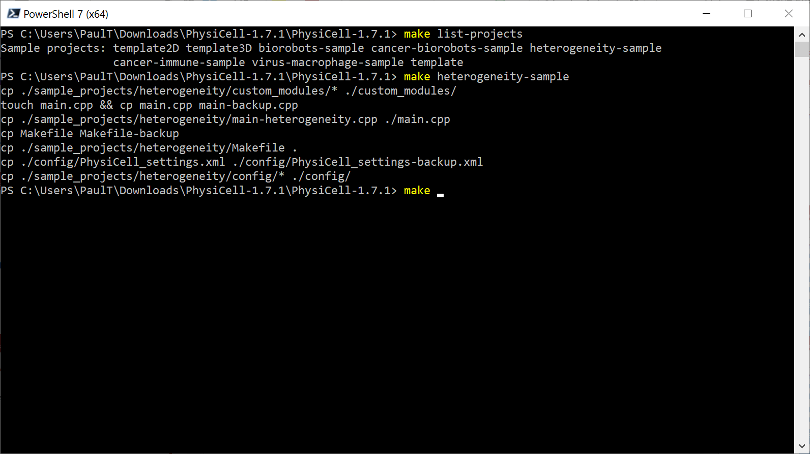
First, populate the cancer heterogeneity project
List all available sample projects
Populate the cancer heterogeneity project
Build the project
Change some settings (next slide)

Slide 22
How to change settings in XML
Open config/PhysiCell_settings.xml
Major sections:
domain -- how big of a region to simulate
overall -- how long to simulate, time step sizes
parallel -- OpenMP settings
save -- how often to save SVG images and full data
microenvironment -- settings on diffusing substrates
user_parameters -- model-specific settings
cell_definitions -- set baseline cell properties

Slide 23
Exercise: change settings and run
Let's set the maximum simulation time to 2160 minutes
Let's set the domain to [-500,500] x [-500,500] to speed it up
Let's set the oncoprotein standard deviation to 3
Let's set the max oncoprotein to 9 (3 standard deviations)
Compile and run as before.

Slide 24
Let's set options and run (1)
Open ./config/PhysiCell-settings.xml
Let's set the domain size in the domain block
Switch to [-500,500] x [-500,500] x [-10,10] to speed it up
<PhysiCell_settings version="devel-version">
<domain>
<x_min>-500</x_min>
<x_max>500</x_max>
<y_min>-500</y_min>
<y_max>500</y_max>
<z_min>-10</z_min>
<z_max>10</z_max>
<dx>20</dx>
<dy>20</dy>
<dz>20</dz>
<use_2D>true</use_2D>
</domain>

Slide 25
Let's set options and run (2)
Let's also look at the user_parameters block
Let's change the oncoprotein standard deviation (oncoprotein_sd) to 3 (more variation)
Let's change the max oncoprotein (oncoprotein_max) to mean + 3 sds = 1 + 9 = 10
<user_parameters>
<tumor_radius type="double" units="micron">250.0</tumor_radius>
<oncoprotein_mean type="double" units="dimensionless">
1.0</oncoprotein_mean>
<oncoprotein_sd type="double" units="dimensionless">3.0</oncoprotein_sd>
<oncoprotein_min type="double" units="dimensionless">0.0</oncoprotein_min>
<oncoprotein_max type="double" units="dimensionless">10</oncoprotein_max>
<random_seed type="int" units="dimensionless">0</random_seed>
</user_parameters>

Slide 26
Let's set options and run (3)
Let's look at the overall block
Set max time to 1.5 days = 1.5 x 24 x 60 = 2160 minutes
<overall>
<max_time units="min">2160</max_time> <!-- 36 h * 60 min -->
<time_units>min</time_units>
<space_units>micron</space_units>
Let's look at the save block
Set the full save interval to 6 hours = 360 minutes
<save>
<folder>output</folder> <!-- use . for root -->
<full_data>
<interval units="min">360</interval>
<enable>true</enable>
</full_data>
Now, run! (./heterogeneity)

Slide 27
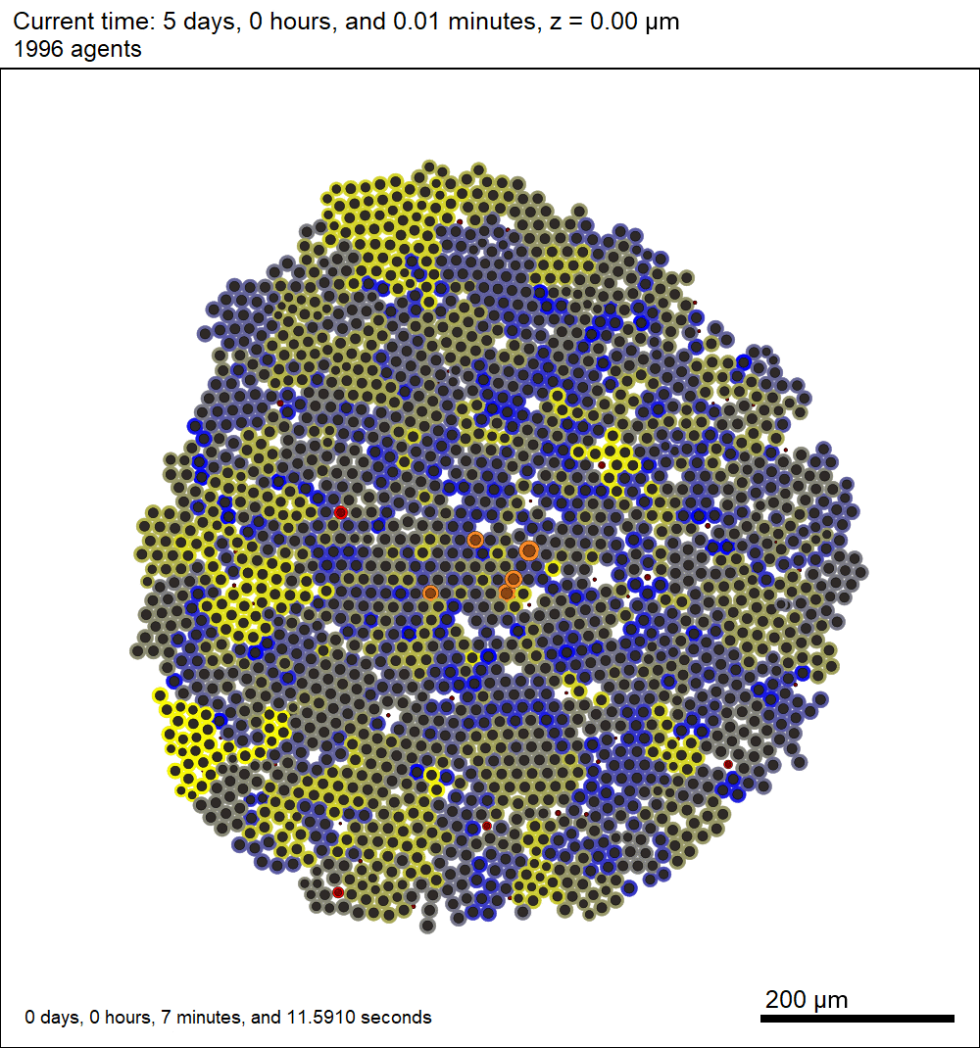
Let's do a quick visualization
magick mogrify -format jpg *.svg
magick convert *.svg out.gif
We can see that the yellow cells eventually "win": they grow faster and form microcolonies within the tumor
The effect is greatest on the outside edge: They have access to more O₂ here

Slide 28
In the next lesson …
We'll learn how to change many of these settings in a graphical editor.

Slide 29




Funding Acknowledgements
PhysiCell Development:
Breast Cancer Research Foundation
Jayne Koskinas Ted Giovanis Foundation for Health and Policy
National Cancer Institute (U01CA232137)
National Science Foundation (1720625)
Training Materials:
Administrative supplement to NCI U01CA232137 (Year 2)

